Slide 1
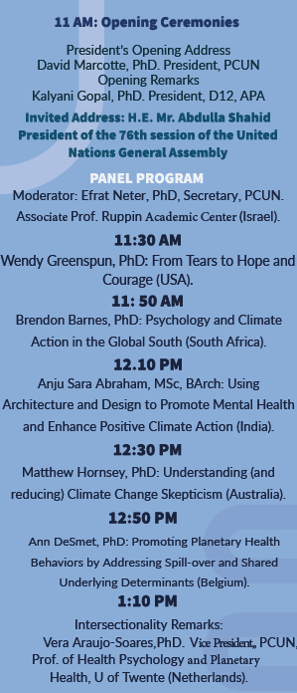
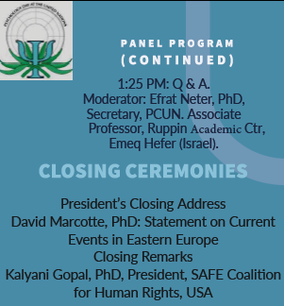
Dan psihologije u Ujedinjenim nacijama – uživo na UDG!
UDG, četvrtak, 21. april
10.00 – 10.30
Gostujuće predavanje prof. dr Harold Takooshian, Fordham University, NYC, PCUN
United Nations Psychology Day
16.30 – 20.00 Prenos uživo
Mission
Psychology Day at the United Nations is a celebration of psychology in the context of the United Nations. It provides an opportunity for psychology to share with U.N. Permanent Missions, U.N. agencies, NGOs and the private sector the activities of psychologists at the U.N. and the role of psychology in addressing concerns of global importance. Psychology Day also introduces psychologists and psychology students to psychology's current and potential involvement in U.N. activities and issues.

